Slide 1



Gargash Hackathon 2025
NEURAL DRIVE
Raj Rangwani
Ruhan Goltay
Divya Kishor

Slide 2


ENABLING DREAMS
Financial Planning App
Set and Track Financial Goals
Live Alerts on Market Price Dynamics
Cross Sell Rental Leases
Facilitate Investment Serivces

Slide 3

ROAD TO RIDE
02
SnowFlake
01
03
CRM with lots of Data
DL Models for predicting Savings
Scrape Market Prices
Web App
Bridge
Customer Enters Details
Enables Credit Card Transactions Data Sharing
Cross Sell:
Real Estate Leases
Investment Products

Slide 4
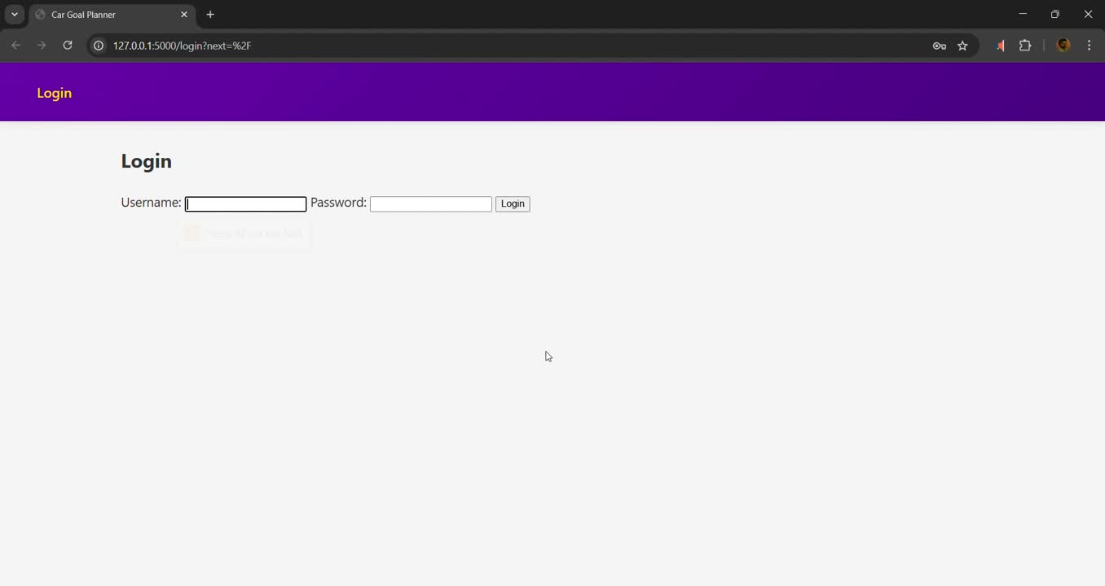
PROTOTYPE

Slide 5

FORWARD DRIVE
Additional Deep Learning Models
Predict customer background, income, home rental based on spending habits.
NLP Integrated Communication
Alerts and interactions taylored to individual customer and current market prices

